Slide 1

RAG from scratch: Query Translation
(Step-back)
Lance Martin
Software Engineer, LangChain
@RLanceMartin
Notes:
Step-back prompting is an approach to improve retrieval that builds on chain-of-thought reasoning. From a question, it generates a step-back (higher level, more abstract) question that can serve as a precondition to correctly answering the original question. This is especially useful in cases where background knowledge or more fundamental understanding is helpful to answer a specific question.
Slides:
https://docs.google.com/presentation/d/1L0MRGVDxYA1eLOR0L_6Ze1l2YV8AhN1QKUtmNA-fJlU/edit?usp=sharing
Code:
https://github.com/langchain-ai/rag-from-scratch/blob/main/rag_from_scratch_5_to_9.ipynb
Reference:
https://arxiv.org/pdf/2310.06117.pdf

Slide 2
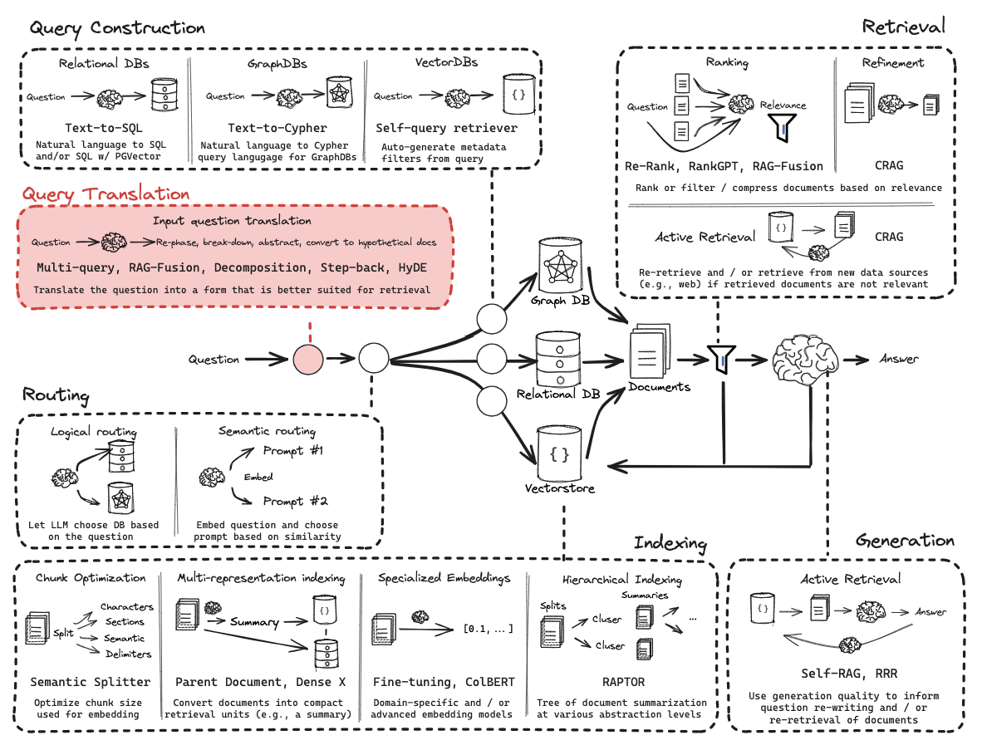
Query Translation

Slide 3
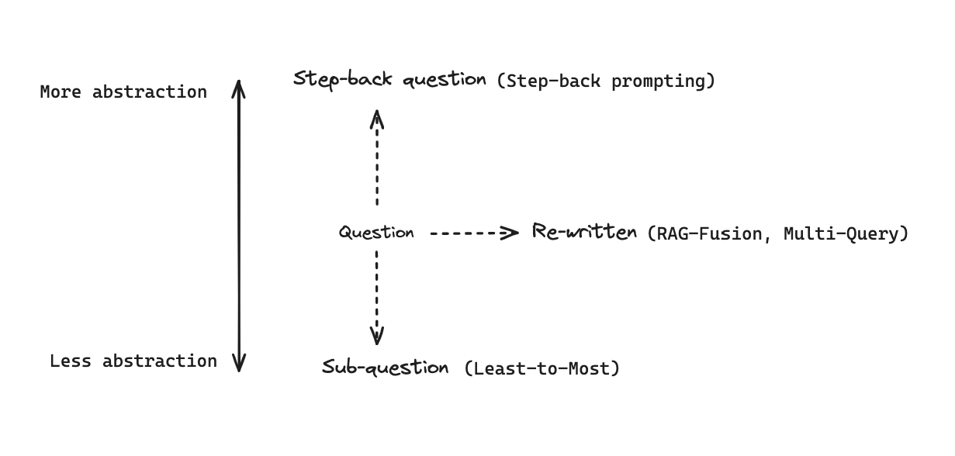
General approaches to transform questions
https://arxiv.org/pdf/2310.06117.pdf

Slide 4
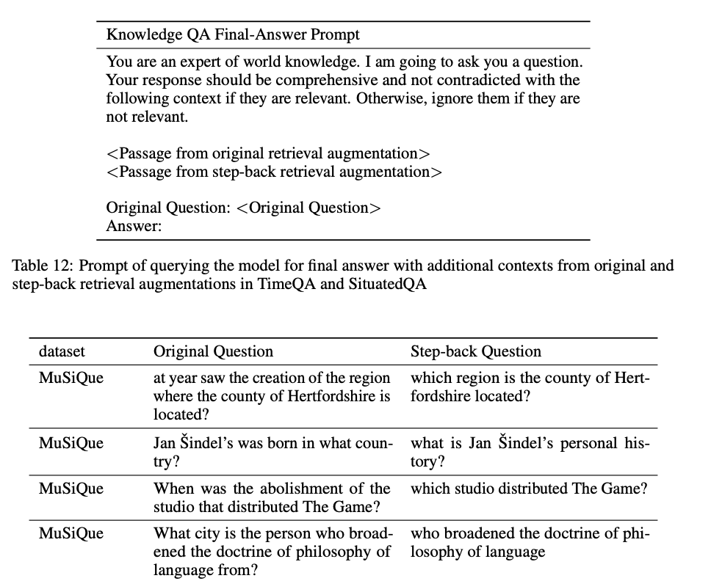
Few shot prompt to produce more abstract step-back question
https://arxiv.org/pdf/2310.06117.pdf

Slide 5
Code walk-through

